Slide 1
Stock Price Prediction
VivEK VARMA (18BCA1292)

Slide 2
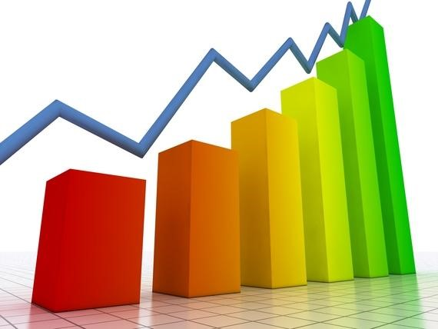
Problem Statement
The aim of the project is to examine a number of different forecasting techniques to predict future stock returns based on past returns and numerical news indicators to construct a portfolio of multiple stocks in order to diversify the risk. We do this by applying supervised learning methods for stock price forecasting by interpreting the seemingly chaotic market data.

Slide 3

Motivation
The fluctuation of stock market is violent and there are many complicated financial indicators. However, the advancement in technology, provides an opportunity to gain steady fortune from stock market and also can help experts to find out the most informative indicators to make better prediction. The prediction of the market value is of paramount importance to help in maximizing the profit of stock option purchase while keeping the risk low.

Slide 4
Steps Involved
Data selection,
Data preprocessing
Data transformation
Data Visualization

Slide 5
Technical Analysis
Based on the principles of the Dow Theory and uses the history of prices to predict future movements.
The approach used in technical analysis can be formulated as a pattern recognition problem, where the inputs are derived from the history of prices and the output is an estimate of the price or an estimate of the prices trend.

Slide 6
Simple Moving Average
Formed by computing the average price of a security over a specified number of periods.
The calculation is repeated for each day on the chart and then joined to form a smooth curve, which makes easier to identify the direction of the trend.
SMA(t)=1/n∑x(i)

Slide 7
Libraries Used
Numpy
Pandas
Matplotlib
Pyplot (has been used majorly in my project) is a collection of functions that make matplotlib work like MATLAB. Each pyplot function makes some change to a figure: e.g., creates a figure, creates a plotting area in a figure, plots some lines in a plotting area, decorates the plot with labels, etc.

Slide 8
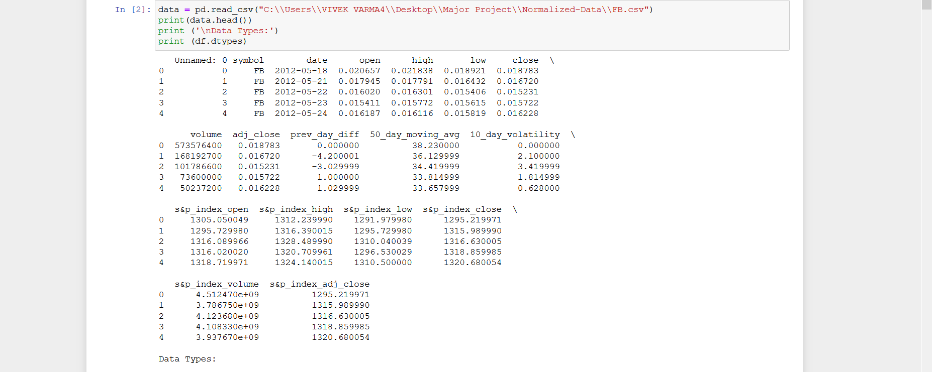
Loading and Handling Data

Slide 9
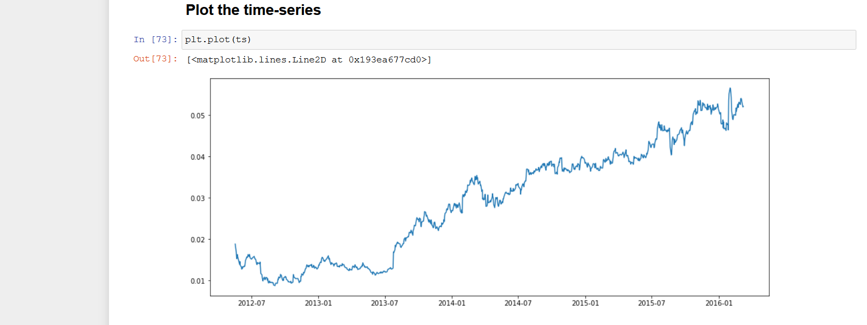
Plot the Timeseries

Slide 11
Explanation about the project will be done Verbally.

Slide 12
Thank You

